Slide 1
IELTS Writing

Slide 2
IELTS Writing Info
No | Task | Minimum words | Recommended time
Task 1 | Describe a graph, table, chart or diagram | 150+ words | 20 minutes
Task 2 | Write an essay giving your opinion and justifying it | 250+ words | 40 minutes

Slide 3
IELTS Writing Task -1

Slide 4
Marking Criteria
Task Achievement
Select the main/key features of the graph, chart, map or process
Write a clear overview that includes the main/key features (main trends, differences, stages etc.) of the graph, chart, map or process
Support them with accurate detail
Write at least 150 words
Coherence and Cohesion
Introduce your essay by paraphrasing the question in the first paragraph
Separate your ideas into paragraphs
Making it clear which paragraph is your overview and having very clear ideas in your overview
Supporting the main points in your overview in separate paragraphs
Making it clear what each paragraph is about
Lexical Resource
Use a range of linking words when appropriate
Use linking words accurately
Do not over-use linking words
Grammatical Range and Accuracy
Do not make errors
Use a range of appropriate tenses
Use a range of appropriate structures
Use both simple and complex sentences
Use correct punctuation

Slide 5
General Structure
1. Introduction - paraphrase the title - 1 or 2 sentences
2. Overview/conclusion - outline 3-4 main points, and events (general trends, features) - 2 to 4 sentences Never write numbers, percentages or dates here
3. Paragraph 1: Feature 1 - Describe the picture giving specific data and examples - Specific features in 2 or three paragraphs
4. Paragraph 2: Feature 2 - another specific feature in 2 or 3 paragraphs

Slide 6
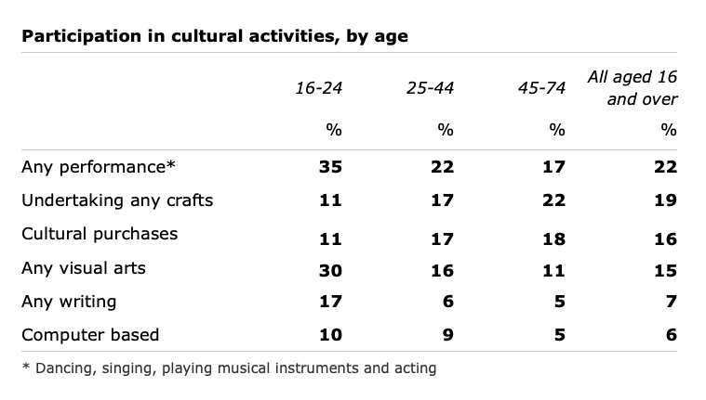
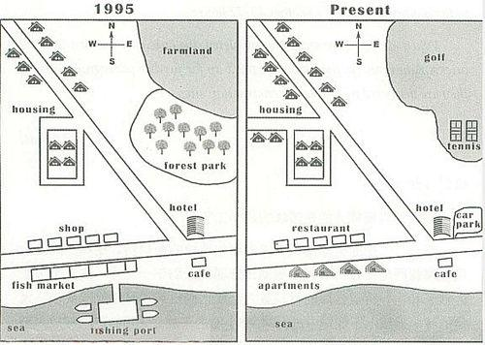
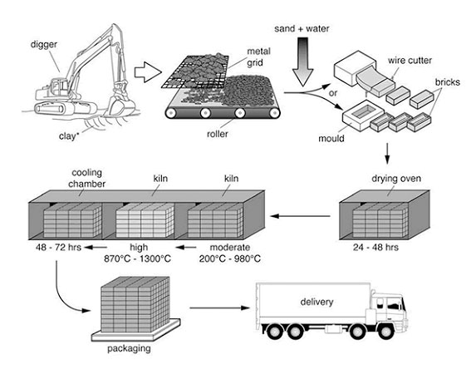
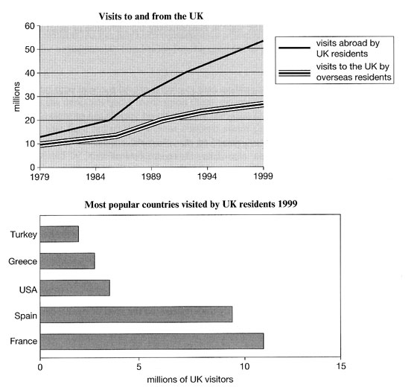
Types of questions
Bar graph
Line graph
Table
Multi-graphs
Process diagram
Maps
Letter writing
Table
Maps
Process diagram
Multi-graphs

Slide 7
Pie Chart, Bar graph, Line graph, Table
1. Introduction - paraphrase the title - 1 or 2 sentences
2. Overview - outline 3-4 main points, and events (general trends, features) - 2 to 4 sentences - Example: Overall, Never write numbers, percentages or dates here
3. Feature 1 - Describe the picture giving specific data and examples - Specific features in 2 or three paragraphs - Make comparisions wherever possible
4. Feature 2 - another specific feature in 2 or 3 paragraphs
For paraphrasing:
The graph/table/pie chart/bar chart/diagram ...
gives information about/on ...
provides information about/on ...
shows ...
illustrates ...
compares ...
explains why ...
describes ...
draws the conclusion of (a survey) ...

Slide 8
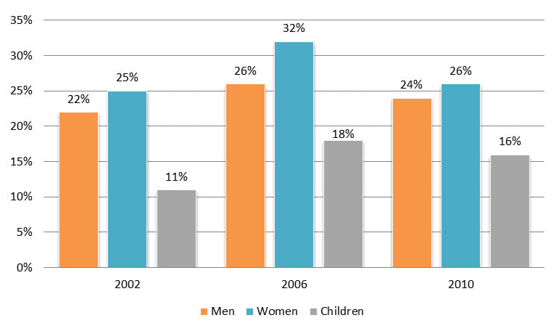
Bar graphs
Percentage of UK people who consumed daily recommended amount of fruit and vegetable in 2002, 2006 and 2010.
Summarize the information by selecting and reporting the main features and make comparisons where relevant.
Introduction:
Paraphrasing
The barchart provides the information about daily recommended amount of fruits and vegetables in 2002, 2006, 2010 of UK people in percentage.

Slide 9
Bar graphs
Percentage of UK people who consumed daily recommended amount of fruit and vegetable in 2002, 2006 and 2010.
Summarize the information by selecting and reporting the main features and make comparisons where relevant.
Overview:
Overall, the women consumed the highest amount of fruits and vegetables while the children were the ones to eat the least.
Paragraph 1:
Only Men in all three years OR
Only about 2002
Paragraph 2:
Only Women in all three years OR
Only about 2006
Paragraph 3:
Only Children in all three years OR
Only about 20

Slide 10
Maps
1. Introduction - paraphrase the title - 1 or 2 sentences
2. Overview - Find 1 to 2 main changes of ... and write it in general statement without numbers - We can use some phrases like: “the addition of / the new construction / the new erection of” Never write numbers, percentages or dates here
3. Body paragraph 1, 2 - Make comparisions between two periods of time in the same part so we can see the differences clearly - Use relative clause to describe the changes - Use some words like “join, connect” - Use sign-posting like “in addition, furthermore, besides” - Emphasize the reallocation or the movement of the original ones
Types:
1. Describe a map in present tense
2. Describe two maps: one is in present and another in future
3. Describe two maps: one is in the past and another in the present
Verbs:
* Expansion (buildings, roads, bridges and railways)
- expanded, extended, developed, enlarged
* Changes
- renovated, replaced, reconstructed, redeveloped, modernised, converted, relocated, transformed
-> Roads, bridges and railways
- reopened, replaced
-> Leisure facilities (renovated, replaced, redeveloped)
* Removement
- demolished, knocked down, removed, pulled down, torn down, flattened
- cut down, chopped down, removed, cleared to make way for/give way to

Slide 11
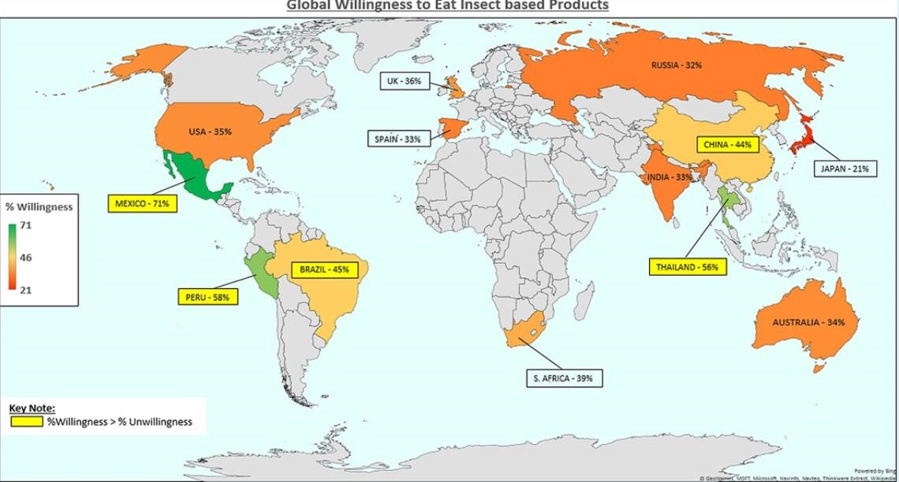
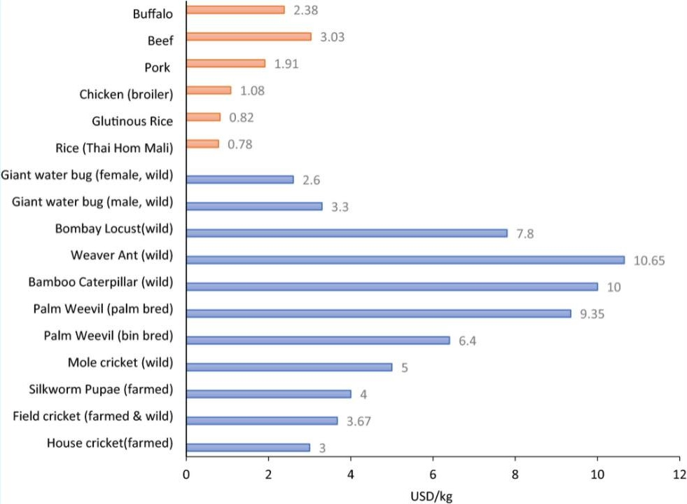
Maps
Q. The map and chart below show the information for the global willingness to eat insect products and the current price for certain food available on the market place.
Paraphrasing:
-> The following map and a chart demonstrates the information about the global consumption of insect products and their present rates for certain food available in the market.
-> In the above map and a chart the global consumption of insect products that is available in the market and its price is shown.
Key features:
-> First feature: the map only
-> Second feature: the chart only

Slide 12
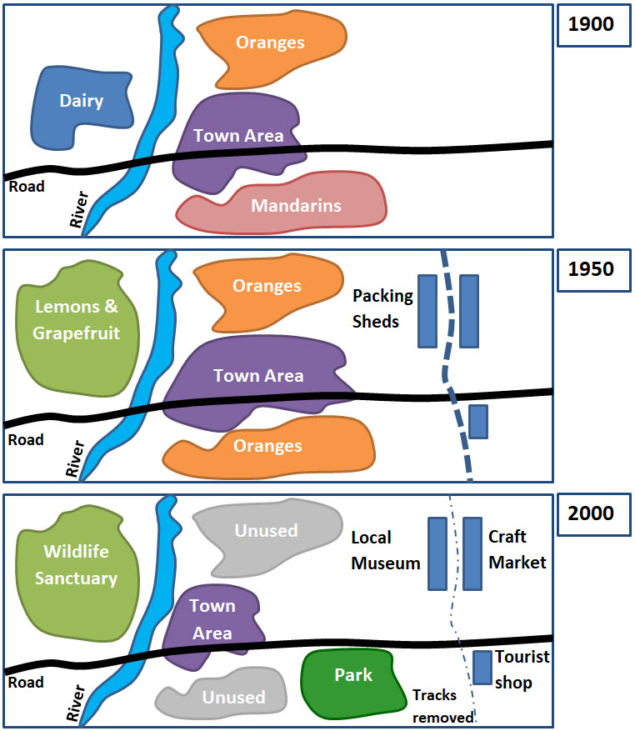
Maps
Q. Tarnagul is a small town near Melbourne. The maps show the town's development over a period of time. Summarise the information by selecting and reporting the main features, and make comparisons where relevant.

Slide 13
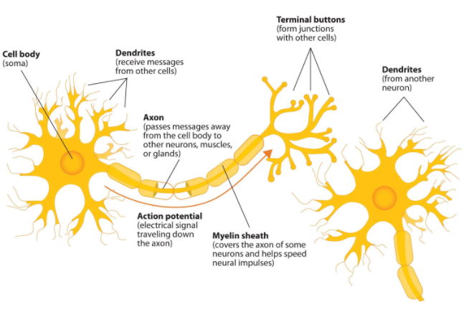
Q. The diagram shows the components of a neuron and how it works
Paraphrasing:
-> The following diagram represents the elements of a neuron and its functions.
-> The below diagram reveals the functionality of different components of a neuron.
-> Below is a picture of a neuron. It shows the different units and its work/function.

Slide 14
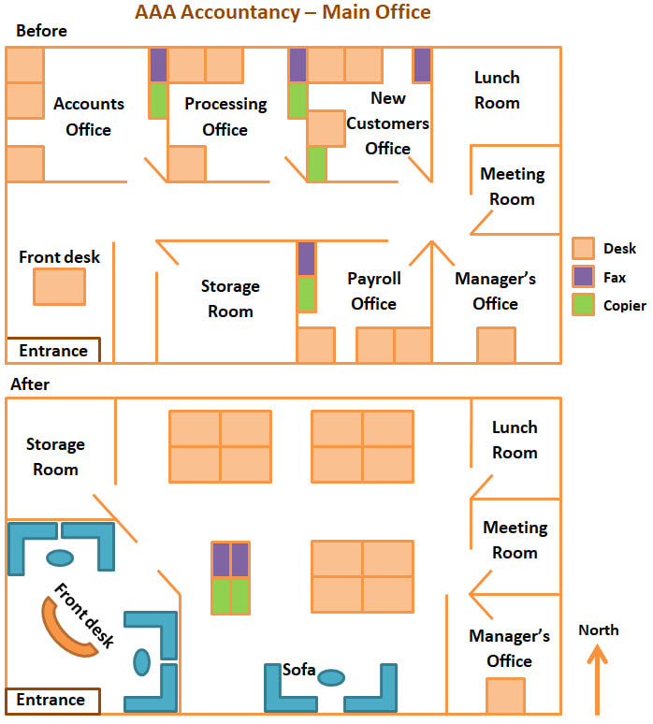
Maps
The two floor plans show the renovation of AAA Accountancy's main office.
Summarise the information by selecting and reporting the main features, and make comparisons where relevant.
Paraphrasing:
-> The two floor reconstruction planning to explain AAA Accountancy’s head office is show below.
-> The below map illustrates the renovating plan of AAA Accountancy’s head office.
Key features:
-> First feature: Before
-> Second feature: After

Slide 15
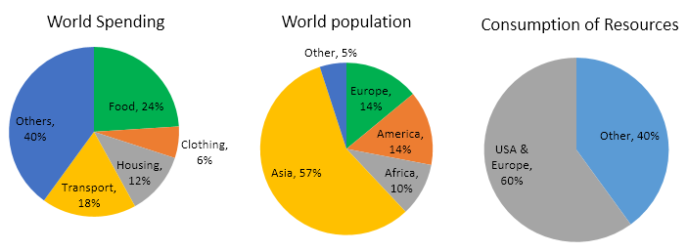
Pie Charts
You should spend about 20 minutes on this task.
The pie charts below give data on the spending and consumption of resources by countries of the world and how the population is distributed.
Summarize the information by selecting and reporting the main features, and make comparisons where relevant.
You should write at least 150 words.

Slide 16
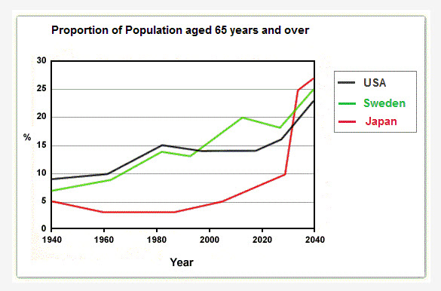
Line graphs
You should spend about 20 minutes on this task.
The graph below shows the proportion of the population aged 65 and over between 1940 and 2040 in three different countries. Summarize the information by selecting and reporting the main features and make comparisons where relevant.
You should write at least 150 words.

Slide 17
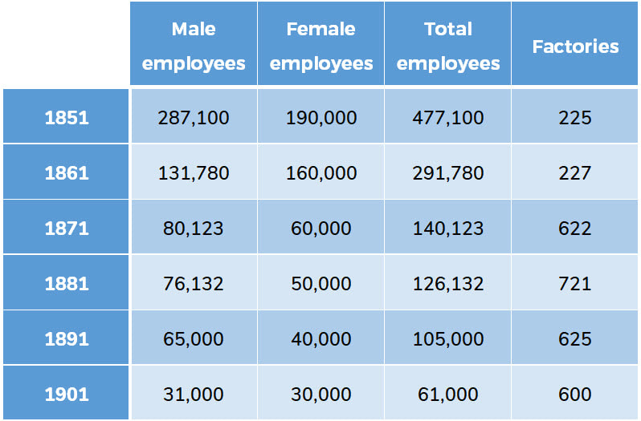
Table
You should spend about 20 minutes on this task.
The table below describes the number of employees and factories in England and Wales from 1851 to 1901. Summarize the information by selecting and reporting the main features and make comparisons where relevant.
You should write at least 150 words.

Slide 18
Process diagram
1. Introduction - paraphrase the title - 1 or 2 sentences
2. Overview - Describe the general features 1. Number of stages 2. How the process begins and ends - If the diagram has loops or repeating stages or the process if cyclic, comment on that too Never write numbers, percentages or dates here - Example: Overall, the process ...
3. Feature 1 - Describe first stage (1st paragraph)
4. Feature 2 - Describe second stage (2nd paragraph) and so on
Connecting words
First of all,
After that,
In the next stage,
Following this,
Subsequently,
Next,
Finally

Slide 19
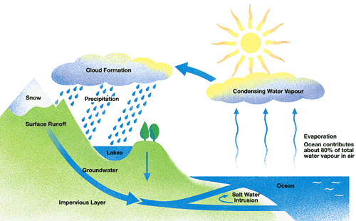
Process diagram
The diagram below shows the water cycle, which is the continuous movement of water on,
above and below the surface of the Earth.

Slide 20
The 10 most common mistakes in Task 1 data essays
Including personal opinion, knowledge or suggestions in the essay.
Putting figures in the introduction sentence or the summary.
Having an introduction or summary that is too long.
Using contractions (eg ‘don’t for ‘do not.’)
Listing the data in the order that you see it in the chart (eg from left to right, or top to bottom.)
Failing to describe the trends and exceptions.
Using too many figures from the data.
Not writing enough words
Not using the data units correctly, or misunderstanding the zeros.
Using the wrong tense.

Slide 21
IELTS Writing Task - 2

Slide 22
Marking Criteria
Task Achievement
Select the main/key features of the graph, chart, map or process
Write a clear overview that includes the main/key features (main trends, differences, stages etc.) of the graph, chart, map or process
Support them with accurate detail
Write at least 150 words
Coherence and Cohesion
Introduce your essay by paraphrasing the question in the first paragraph
Separate your ideas into paragraphs
Making it clear which paragraph is your overview and having very clear ideas in your overview
Supporting the main points in your overview in separate paragraphs
Making it clear what each paragraph is about
Lexical Resource
Use a range of linking words when appropriate
Use linking words accurately
Do not over-use linking words
Grammatical Range and Accuracy
Do not make errors
Use a range of appropriate tenses
Use a range of appropriate structures
Use both simple and complex sentences
Use correct punctuation

Slide 23
Types of questions
Advantages and disadvantages
Outweigh essay: present your opinion and explain it
Causes and solutions essay
solutions only
cause and solution
Problem solution
Agree/disagree essay
do you agree?, what is your opinion?, to what extent do you agree?
pick one opinion for which you can generate more supporting points (explanation why you chose that particular opinion)
Discussion essay (discuss both views and give your opinion)
Direct question essay (may contain one, two or three question)

Slide 24
General Structure
1. Introduction
2. Body paragraph 1
3. Body paragraph 2
4. Conclusion

Slide 25
Writing task type: Agree/disagree essay
1. Introduction - paraphrase the statement - You can start with: It is argued that..., It is considered that..., It is thought that... - tell the examineer what you’re going to describe agree/disagree --> paraphrase + I agree/disagree with the notion that ... OR I completely (agree/disagree) with this opinion and think that ...
2. Body paragraph 1 [around 4-5 sentences] - state the reason why you agree/disagree - explain your reason - give an example - write a short summary of your ideas | A good way to introduce the first supporting point, is to use phrase firstly or first of all
3. Body paragraph 2 [around 4-5 sentences] - state the reason why you agree/disagree - explain your reason - give an example - write a short summary of your ideas
4. Conclusion - Briefly summarize what you’ve written

Slide 26
Writing task type: Agree/disagree essay
You should spend about 40 minutes on this task.
Individuals can do nothing to improve the environment; only governments and large companies can make a difference. To what extent do you agree or disagree?
Give reasons for your answer and include any relevant examples from your own knowledge or experience. You should write at least 250 words.
Due to the increase in population, our environment is getting polluted day by day because people are throwing garbages wherever they like. For this, only the government and large enterprises are responsible while individuals are not. For this, individuals are helpless and only the government and enterprises can bring the changes. To solve this problem, people cannot do anything whereas, ... I agree/disagree with the notion that
Body paragraph(1) 1st reason: it’s difficult, examples,
Body paragraph(2) 2nd reason: takes more time, examples,

Slide 27
Writing task type: Agree/disagree essay
You should spend about 40 minutes on this task.
Beside a lot of advantages, some people believe that the Internet creates many problems. To what extent do you agree or disagree with this statement?
Give reasons for your answer and include any relevant examples from your own knowledge or experience. You should write at least 250 words.
Introduction

Slide 28
Writing task type: Agree/disagree essay
You should spend about 40 minutes on this task.
Public libraries should provide books and not waste their limited resources on expensive high-tech media such as software, videos or Dvds. Do you agree or disagree?
Give reasons for your answer and include any relevant examples from your own knowledge or experience. You should write at least 250 words.
Introduction

Slide 29
Writing task type: Advantages and advantages essay
1. Introduction - paraphrase the title - tell the examineer what you’re going to describe in the essay
2. Body paragraph 1 - Describe advantages at least two - give an example - write a short summary of your ideas
3. Body paragraph 2 - Describe disadvantages at least two - give an example - write a short summary of your ideas
4. Conclusion - Briefly summarise what you’ve written - Give the final opinion

Slide 30
Writing task type: Causes and solutions essay
1. Introduction - paraphrase the statement - tell the examineer what you’re going to describe causes/solutions --> paraphrase + This essay will examine the main causes of ... and possible solutions to this problem.
2. Body paragraph 1 - Describe the causes at least two - give an example - write a short summary of your ideas
3. Body paragraph 2 - Describe solutions at least two - give an example - write a short summary of your ideas
4. Conclusion - Brief summary of what’s written

Slide 31
Writing task type: Discussion essay (discuss both views and give your opinion)
1. Introduction paraphrase the statement ways for paraphrasing It is often argued that ..., It is widely believed that ..., It is commonly suggested that ...
2. Body paragraph 1 - First view हेल - Explain - Example
3. Body paragraph 2 - Second view - Explain - Example
4. Conclusion - Summarize both views + main points - Give opinion
Outlining statement Linking words (although, while, overall)
In my opinion, I believe that, although ..., overall ...

Slide 32
Writing task type: Direct question essay
1. Introduction paraphrase question outline the statement This essay will consider the nature of these changes and discuss whether .... or .....
2. Body paragraph 1 - Directly answer the 1st question - Give reasons - Give an example
3. Body paragraph 2 - Directly answer the 2nd question - Give reasons - Give an example
4. Conclusion - Summarize the answers to both questions

Slide 33
Practice Questions

Slide 34
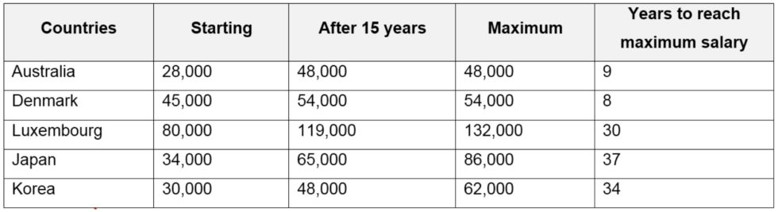
Practise Questions: Task -1
The table below shows the salaries of secondary/high school teachers in 2009. Summarize the information by selecting and reporting the main features and make comparison where relevant.

Slide 35
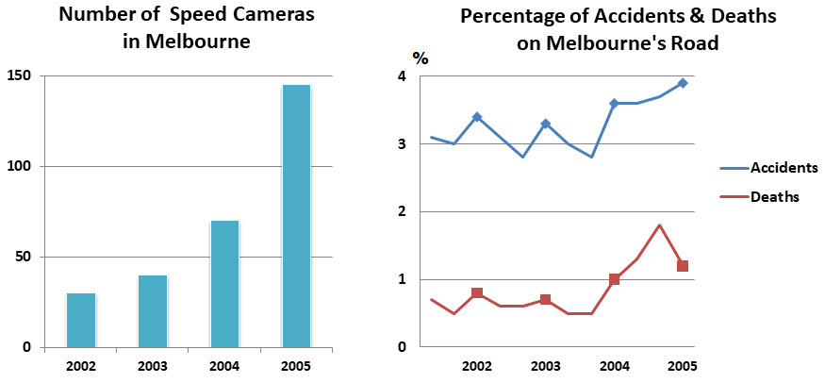
Practise Questions: Task -1
2. The charts show information concerning speed-camera use, together with statistics on road accidents, for the city of Melbourne. Summaries the information by selecting and reporting the main features, and make comparisons where relevant.

Slide 36
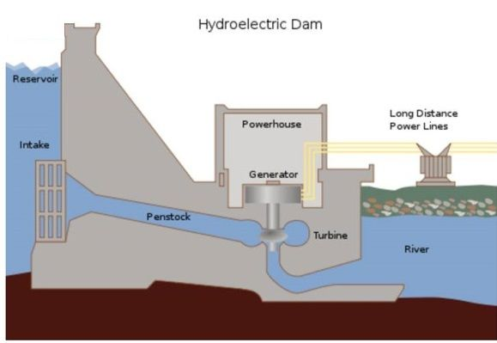
Practise Questions: Task -1
3. The diagram shows the production of hydroelectricity. Summarise the information by selecting and reporting the main features, and make comparisons where relevant.

Slide 37
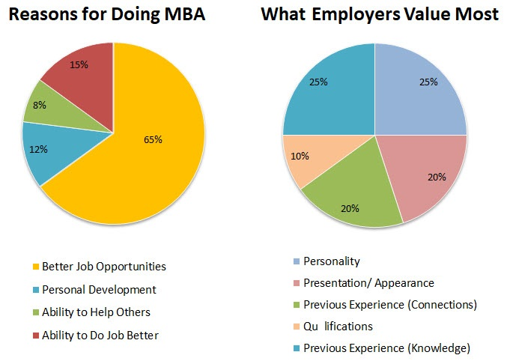
Practise Questions: Task -1
4. The charts show survey results concerning why MBA graduates chose their degree, and employer's reasons for hiring them. Summarise the information by selecting and reporting the main features, and make comparisons where relevant.

Slide 38
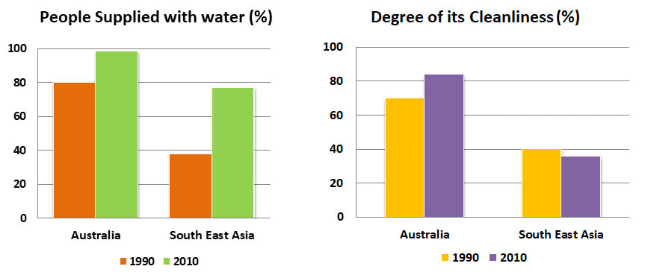
Practise Questions: Task -1
5. The charts show the amount and quality of water supplied to two regions of the world.Summarise the information by selecting and reporting the main features, and make comparisons where relevant.

Slide 39
Practise Questions: Task 2
Many people today, especially in the developed world, are choosing to have fewer children, or none at all. Why is this happening, and do you think it is a good trend? Give reasons for your answer, and include any relevant examples from your own knowledge or experience.
Today, the high sales of popular consumer goods reflect the power of advertising and not the real needs of the society in which they are sold. To what extent do you agree or disagree?
The tendency of news reports in the media to focus more on problems and emergencies rather than on positive developments is harmful to the individuals and the society as a whole. To what extent do you agree or disagree?
Farmers within a country are often protected by tariffs - that is, special taxes on imported food. Such policies are necessary, and should be implemented wherever possible. To what extent do you agree with this? Give reasons for your answer, and include any relevant examples from your own knowledge or experience.
The use of corporal punishment (physically hitting students) in schools is in decline, yet it should be used to improve behaviour. To what extent do you agree or disagree with this statement?
Missions to explore space are hugely expensive, and there are problems on Earth which demand attention. The number of these missions needs to be reduced. Do you agree or disagree?

Slide 40
Practise Questions: Task 2
7. The Internet is now used all around the world as a source of information and communication. However, it's often controversial, so many people think it needs to be controlled. Others believe there should be no interference whatsoever. Discuss both points of view, and give your opinion. Give reasons for your answer, and include any relevant examples from your own knowledge or experience.
8. The movement of people from the countryside into the cities is happening in many parts of the world, resulting in the problems, especially in cities. What are the causes of this movement, and how can it be reversed. Give reasons for your answer, and include any relevant examples from your own knowledge or experience.
9. There is too much noise in many public places in cities. What are the causes of this problem? What can be done to solve the problem?
10.

